Slide 1
Training. What’s it all about?

Slide 2
What is the purpose of training?
All training is aimed at creating long-term physical changes in the body systems. These changes are referred to as adaptations.
Rowing in regattas requires us to give a full gas effort for 11 to 15 minutes, and is classed as an endurance sport.
This means we need to train to get stronger so we can get the boat to go faster AND train the cardiovascular systems (heart and lungs) so we can KEEP the boat going faster for the length of the regatta!

Slide 3
What’s happening in your body?
When your body is working hard, as in a rowing regatta, the following things are happening:-
Your muscles are using the energy supplies in your body in order to produce work.
To do this they need oxygen.
The oxygen comes from the blood that is being pumped around the body by the heart.
The blood gets it’s oxygen from the lungs.
The harder you work, the faster your heart needs to pump to supply the oxygen and the faster you breathe to be able to supply the oxygen needed.

Slide 4
Muscles.
Increase strength
Increase endurance

Slide 5
The Heart.
Increase efficiency to pump more blood and oxygen to the muscles.

Slide 6
The lungs
Increase the amount of oxygen they give to the blood.

Slide 7
Energy systems.
The body’s muscles must have a source of energy.
There are three systems for getting energy depending on the level of effort.

Slide 8
The Phospho-creatine system
This only lasts for up to 10 to 15 seconds.
It’s a chemical reaction in the muscles using something called ATP
It’s the basis for all our energy requirements.

Slide 9
Anaerobic System
Glycogen stored in the muscles is broken down through anaerobic glycolysis, to produce ATP.
Can only be used for 1 or 2 minutes.

Slide 10
Aerobic System
Oxygen, Glycogen, proteins and fats are all processed in specialised parts of the muscles called mitochondria to produce ATP.
Can be used almost indefinitely as long as the effort is not too high!

Slide 11
How does this relate to exercise and rowing?
Our regattas last anywhere from 10 to 15 minutes and the majority of the race will be in the Aerobic zone.
When the intensity of the exercise increases so that the aerobic system can’t supply all of the energy, the anaerobic system has to kick in. This is called the anaerobic threshold.
The fitter you are, the longer you can fuel your body with the aerobic system before the anaerobic system needs to take over.
One of the aims of training for endurance is to raise the level of the Anaerobic Threshold.

Slide 12
The training zones. Can they be changed!!
Maximum heart rate gets lower with age. A rough guide is that your max HR is 220 – your age! You can’t really train to get your max HR higher.
The zones can be changed with training:
Eg the top of the aerobic zone can be increased to 85% or even higher as your body becomes more efficient ie increasing the anaerobic threshold.
Our aim during a race is to be as high into the aerobic zone as possible and only going into the anaerobic zone towards the end for a sprint finish!!

Slide 13
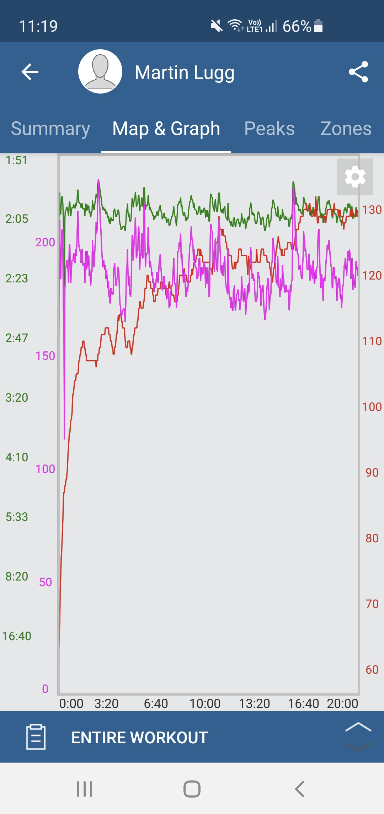
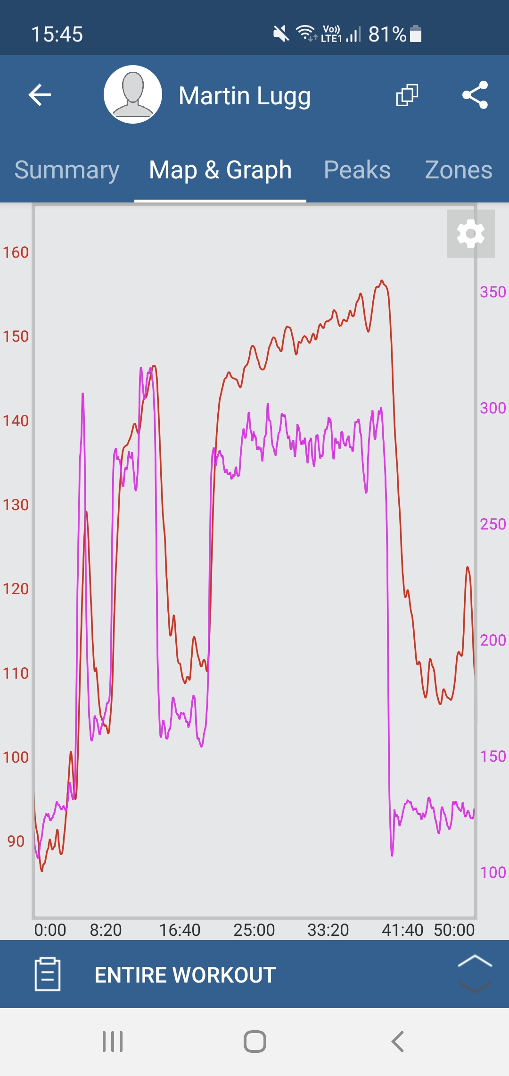
Some examples of heart rate during exercise.

Slide 14
What training should you do?

Slide 15
Interval training.
Interval training is very good for raising the AT. This is when you alternate periods of aerobic exercise with periods of anaerobic exercise.
An example might be to row (cycle, swim, run) aerobically with a heart rate of around 65 to 75% MHR for 3 or 4 minutes and then increase the intensity into the anaerobic zone (~85% MHR) for about a minute then repeat several times.

Slide 16
Aerobic or Endurance training
This type of training involves longer periods of exercise in the aerobic zone. The purpose is to increase the efficiency of the muscles and hence endurance.

Slide 17
What should your heart rate be when you’re training?

Slide 18
Strength training.
One of the principles of getting stronger muscles is resistance training.
Using your muscles against a high resistance causes micro damage to muscle fibres that are then repaired after the workout.
The body rebuilds muscle to be bigger and stronger.
Doesn’t have to be lifting weights in a gym. Could be circuit training, press-ups, sit-ups, rowing hard into a head wind, racing starts!!

Slide 19
FITT - (Frequency, Intensity, Time, Type)
Frequency is increased by training a greater number of times each week.
Intensity is increased by lifting a greater resistance, such as with weight training, or by training at a higher percentage of maximum heart rate.
Time can be manipulated by training for longer, reducing recovery times or by completing a greater number of sets or repetitions (also known as reps).
Type of training is manipulated by offering a variety of training types and experiences to the athlete by combining training methods.

Slide 20
Rest and recovery
Physical adaptations happen during the recovery after your sessions.
Rest between sessions,
Good sleep
The right nutrition, including the use of carbohydrate and protein, especially after a hard session, to help repair the damage caused by intense training.

Slide 21
Overtraining
If you don’t have sufficient rest periods you are at risk of overtraining. This is when the body does not have time to adapt to the training and as a result your fitness declines and you’re more at risk of becoming ill or injured.

Slide 22
Using a heart rate monitor (HRM) is a very good way of:
Making sure that you’re training in the right zone. It’s easy to be either not working hard enough during a high intensity session or working too hard during a steady, lower intensity session.
Keeping track of your fitness levels. Are you going faster with the same heart rate compared to a month ago?
Are you tired? If you’re tired or maybe getting a virus, your heart rate may be higher than you’re expecting it to be. Time to ease up for a while maybe?

Slide 23
Other exercise?
We’re not able to go rowing that often each week, especially in the winter. What else can you do to increase your fitness?
Indoor rowing machines are ideal! They replicate rowing, you can workout from a few minutes to whatever you like and can closely monitor your results. They’re not for everyone but they are very effective.
Cycling – either outdoors or on an indoor trainer. Perfect for cardiovascular training, stamina and leg strength. Not so good for the upper body!!

Slide 24
Running – again great for cardiovascular training and stamina. If you haven’t run much before then take it very, very easy to start with.
Swimming – same as for running and cycling but more of a whole body exercise.
Gym classes/ circuit training. Good for increasing strength and using muscles you didn’t know you had!!
Yoga / Pilates / Tai Chi etc - great for flexibility and general well being.

Slide 25
The way forward.
Consistency and variety is the key to getting better.
Do some kind of training most days, even for a short time.
Do different activities and different levels of effort.
Get a heart rate monitor and tune in to what your heart’s doing.
Remember – everything's a training opportunity!!

Slide 26
Happy Training!

